Slide 1
House Price Prediction
-Eshan Kushwah
-Anushree M

Slide 2
OUTLINE
Introduction
Problem Statement
Dataset
Libraries Used
Data Cleaning
One Hot Encoding
Model Creation
Model Selection
Hyper Parameter Optimization
Prediction

Slide 3
Introduction
Buying house is a stressful thing.
Buyers are generally not aware of factors that influence the house prices.
In this project we have built a machine learning model to predict the saleprice of the house.
This project will be very helpful for the real estate market.
Different algorithms are used to create a model with a great accuracy score.

Slide 4
Problem statement
The objective of my dataset is to predict the house prices using machine learning aims to develop a model that accurately estimates property values based on features like location, size, amenities, etc.
Despite this, we do not have accurate measures of house prices based on the vast amount of data available.
Proper and justified prices of properties can bring in a lot of transparency and trust back to the real estate industry , which is very important for most consumers especially in India.

Slide 5
applications
Real Estate Valuation: ML models estimate property values for homeowners, sellers, and real estate professionals.
Investment Decision-Making: Investors use these models to identify properties with the potential for appreciation.
Property Listing Services: Online platforms offer automated valuation estimates to help sellers set competitive prices.
Mortgage Lending: Banks and financial institutions use ML models to assess property values for loan approval and pricing.

Slide 6
dataset
Our data comes from a Kaggle competition names House Prices: Advanced Regression Techniques.
Link of the dataset – ‘’https://www.kaggle.com/competitions/house-prices-advanced-regression-techniques/data’’
It contains 1460 training data points and 80 features that might help us predict the selling price of a house.

Slide 7
Libraries used
Pandas: Pandas is a Python library used for working with data sets. It has functions for analyzing, cleaning, exploring, and manipulating data.
Numpy: NumPy is a Python library used for working with arrays. It also has functions for working in domain of linear algebra, fourier transform, and matrices.
Matplotlib: Matplotlib is a low level graph plotting library in python that serves as a visualization utility.
Seaborn: Seaborn is a Python data visualization library based on matplotlib. It provides a high-level interface for drawing attractive and informative statistical graphics.

Slide 8
Streamlit: Streamlit is an open source app framework in Python language. It helps us create web apps for data science and machine learning in a short time. It is compatible with major Python libraries such as scikit-learn, Keras, PyTorch, SymPy(latex), NumPy, pandas, Matplotlib etc.
Sklearn: Scikit-learn (Sklearn) is the most useful and robust library for machine learning in Python. It provides a selection of efficient tools for machine learning and statistical modeling including classification, regression, clustering and dimensionality reduction via a consistence interface in Python.

Slide 9
Data cleaning
The main aim of Data Cleaning is to identify and remove errors & duplicate data , in order to create a reliable dataset.
The process of data cleaning is done by using a very famous library pandas .
Initially ,those columns /features are dropped from our dataset who are not important in deciding the final price .
We have imputed the missing values in each numerical column with the mean value of that column.
We have imputed the missing values in each categorical column with the mode value of that column.

Slide 10
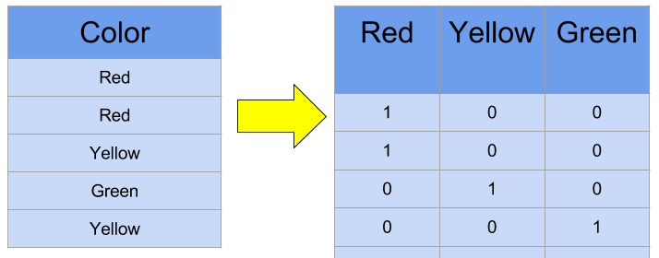
One hot encoding
This technique is used to convert the categorical variables into numeric values.
Our dataset contains several categorical variables.
We have used one hot encoding method to convert them as numeric values.

Slide 11
Model creation
The process of modelling means training a machine learning algorithm to predict the labels from the features.
We have used Linear Regression , Decision Tree Regressor , xgboost algorithms for training and testing of the model.

Slide 12
Linear Regression: Linear regression is a data analysis technique that predicts the value of unknown data by using another related and known data value. It mathematically models the unknown or dependent variable and the known or independent variable as a linear equation.
Decision Tree Regressor: Decision trees is a type of supervised machine learning algorithm that is used by the Train Using AutoML tool and classifies or regresses the data using true or false answers to certain questions. The resulting structure, when visualized, is in the form of a tree with different types of nodes—root, internal, and leaf.
XGBoost: XGBoost is a robust machine-learning algorithm that can help you understand your data and make better decisions. XGBoost is an implementation of gradient-boosting decision trees. It has been used by data scientists and researchers worldwide to optimize their machine-learning models.

Slide 13
Model selection
The highest accuracy was given by XGBoost model is 85% which is pretty good.
XGBoost offers a wide range of hyperparameters that can be fine-tuned to optimize performance .
XGBoost is optimized for both speed and scalability . It can handle large datasets and is faster to train compared to some other algorithms ,including linear regression.
XGBoost has built-in mechanisms to handle missing data , reducing the need for extensive data preprocessing .Linear Regression and Decision Trees may require more data imputation.

Slide 14
Hyperparameter Optimization
Enhanced Performance: Tuned hyperparameters lead to better model accuracy and reduced errors.
Overfitting Prevention: Optimization ensures the model generalizes well to new data by avoiding overfitting.
Efficiency: Automated optimization saves time and computational resources .
Real-World Impact: Improved performance benefits real-world applications across domains.

Slide 15
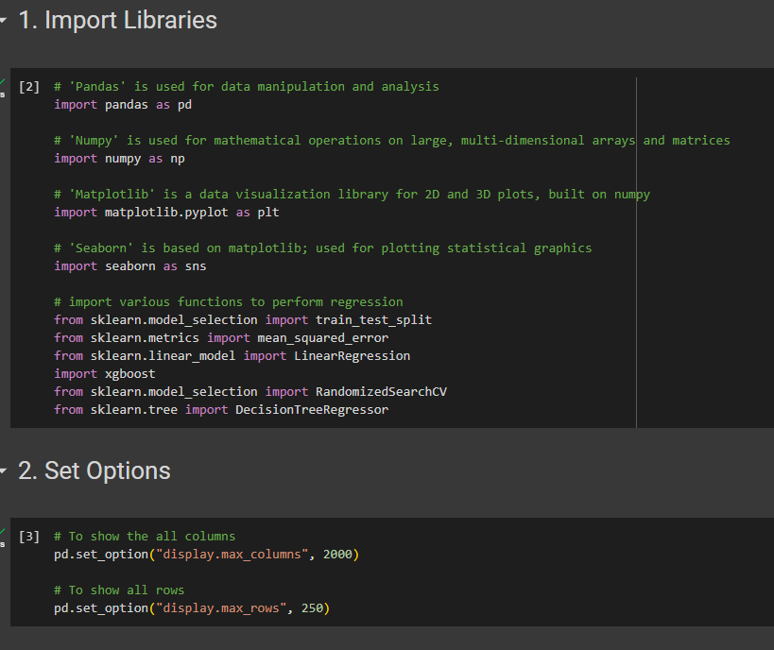
code

Slide 16
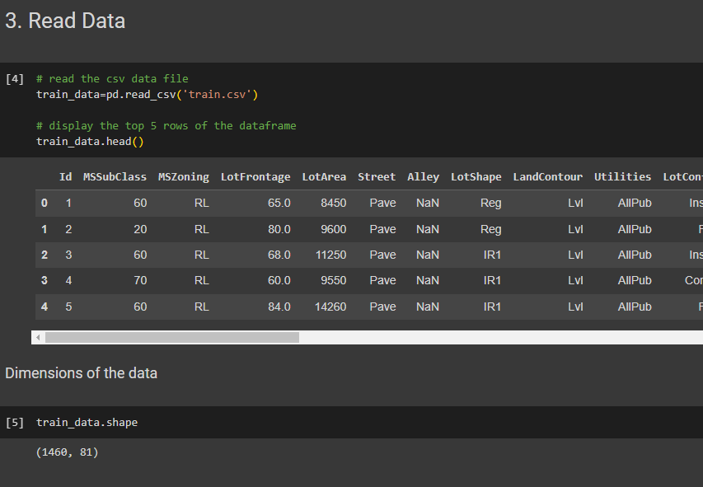

Slide 17
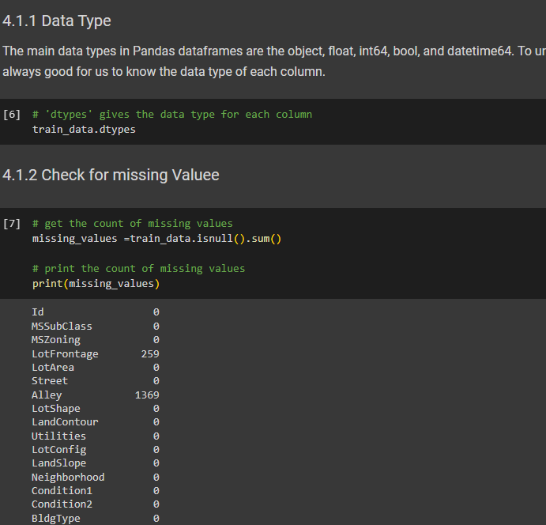

Slide 18
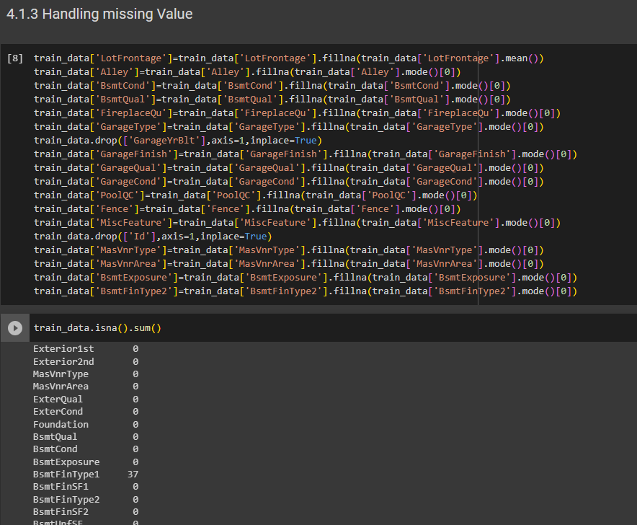

Slide 19
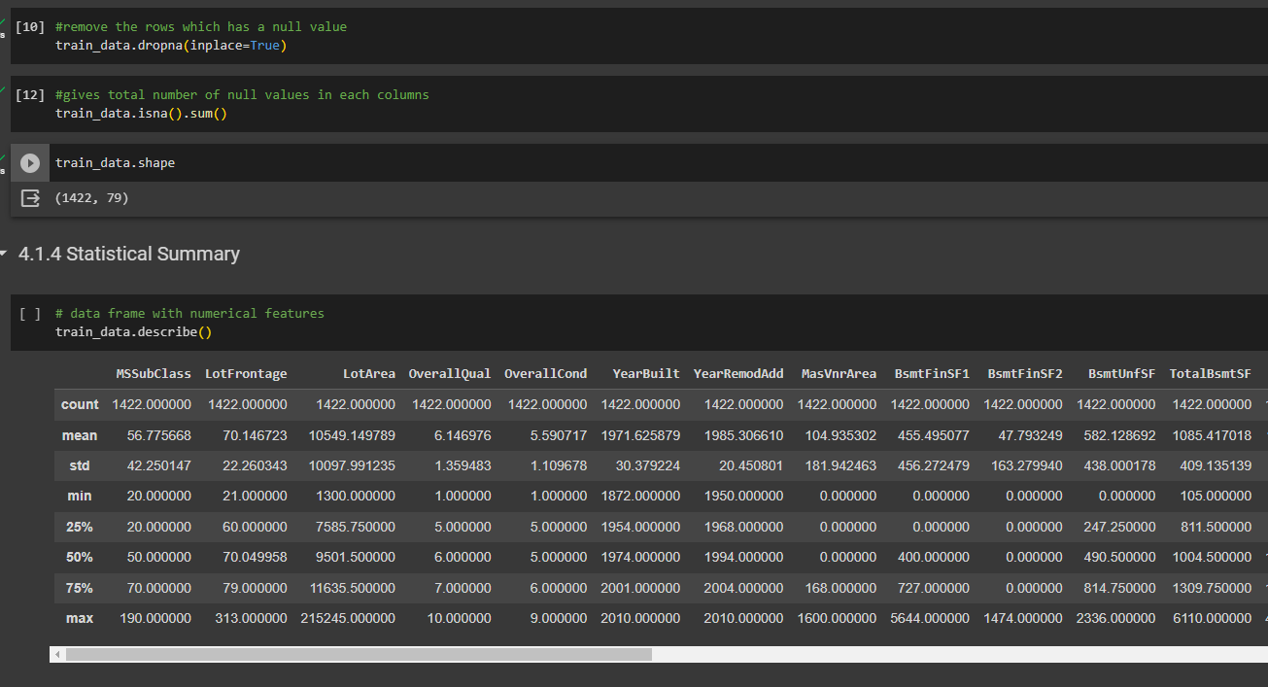

Slide 20
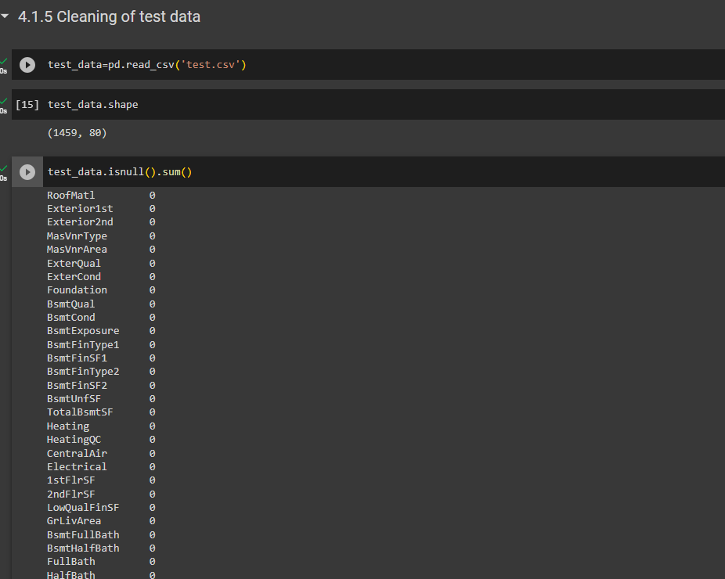

Slide 21
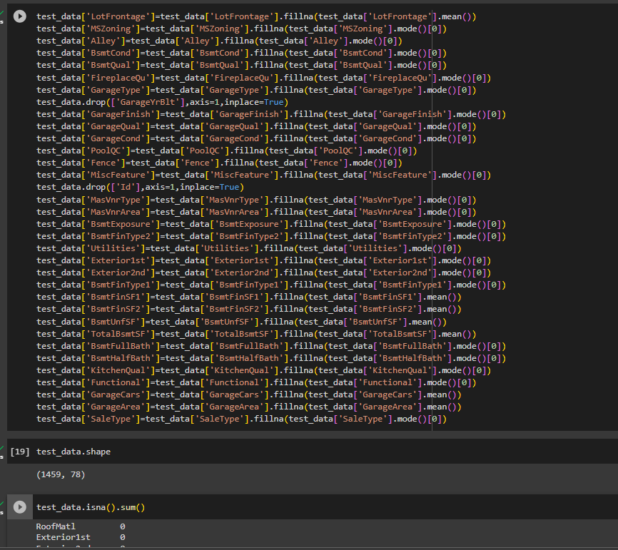

Slide 22
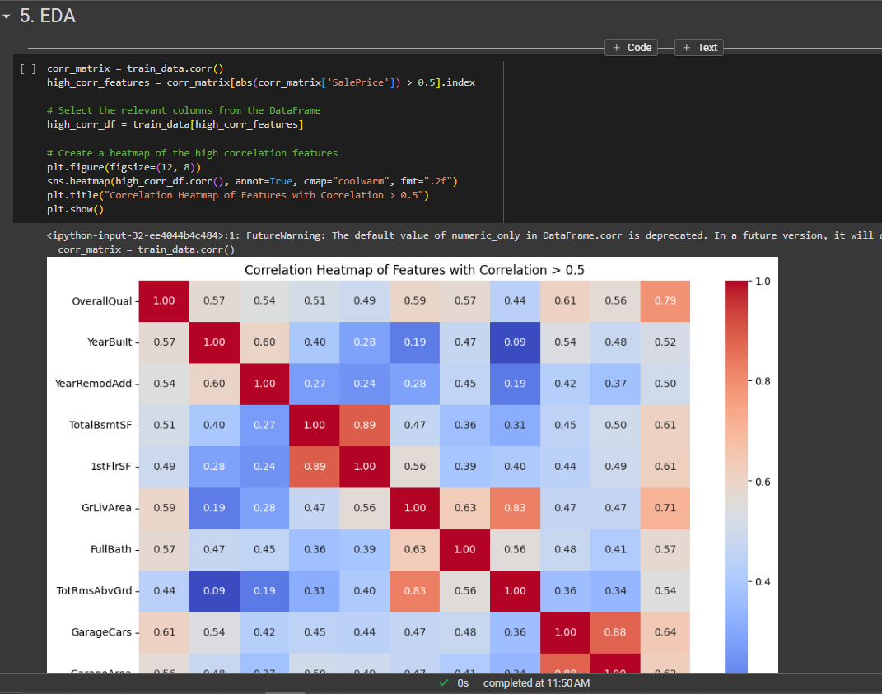

Slide 23
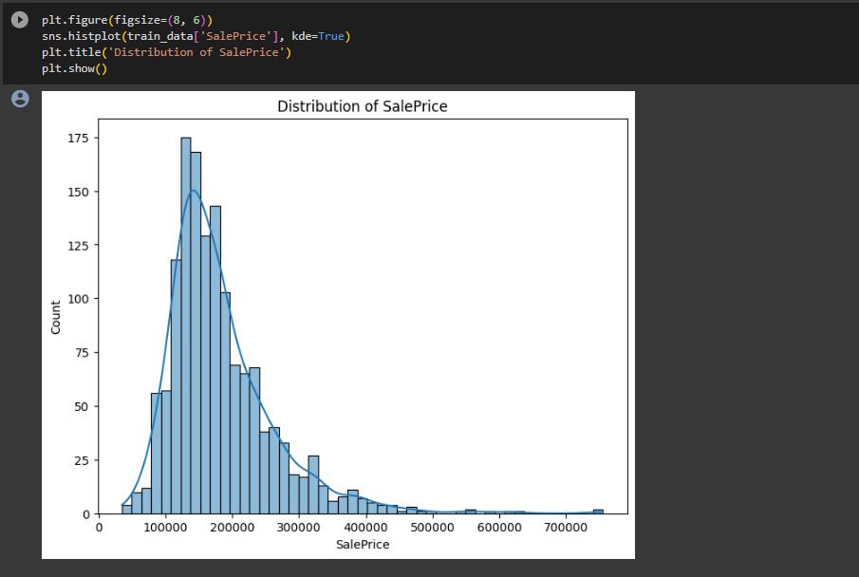

Slide 24
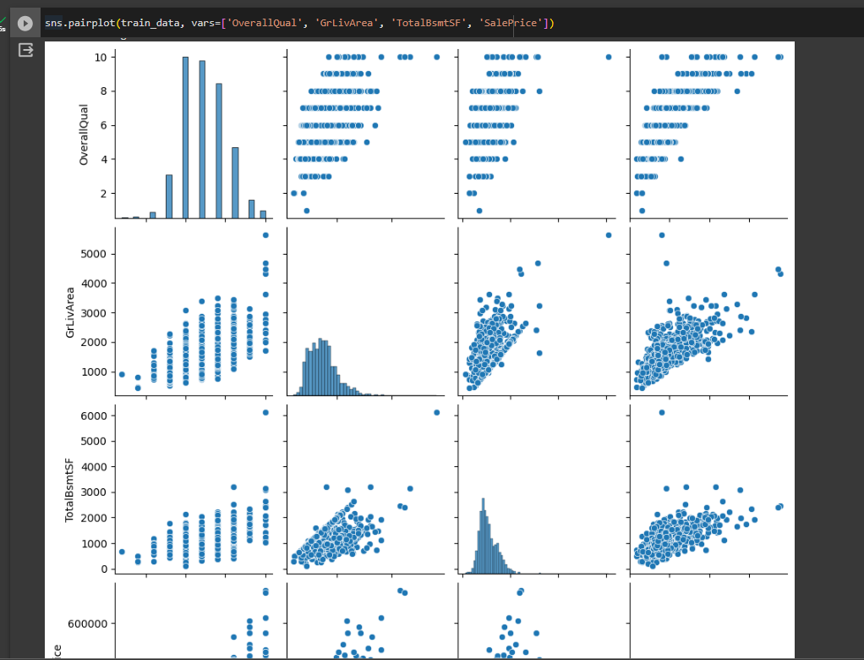

Slide 25
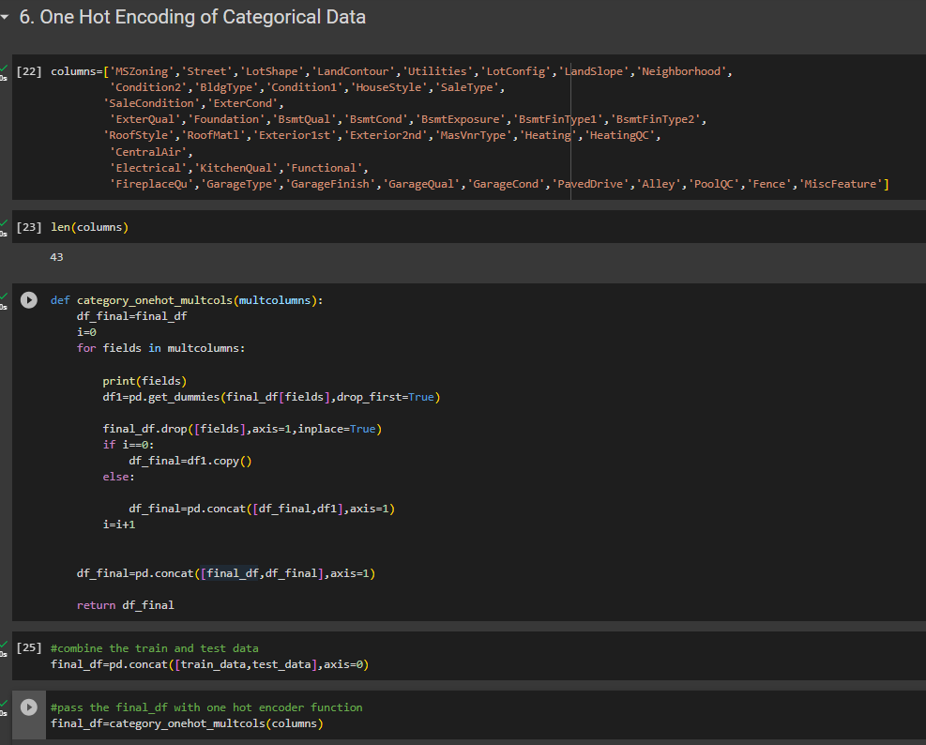

Slide 26
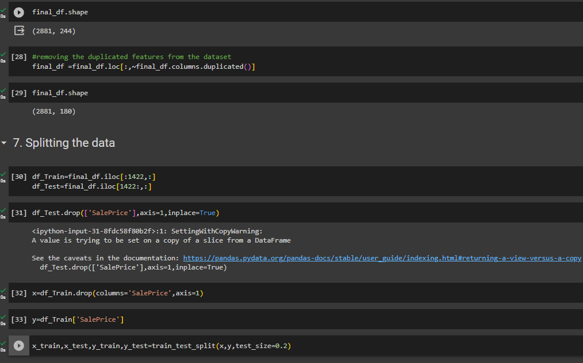

Slide 27
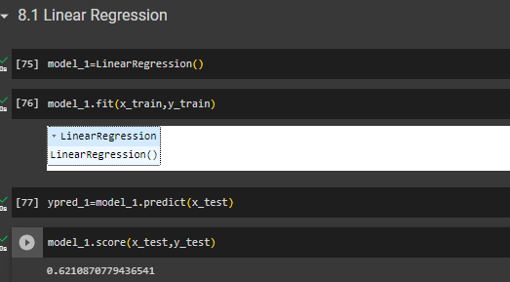
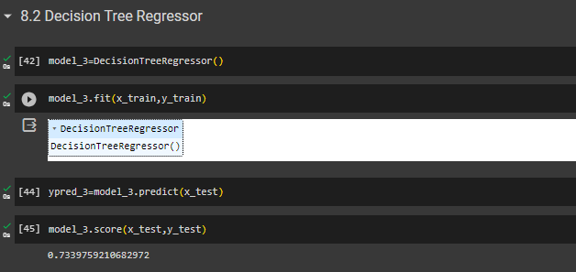

Slide 28
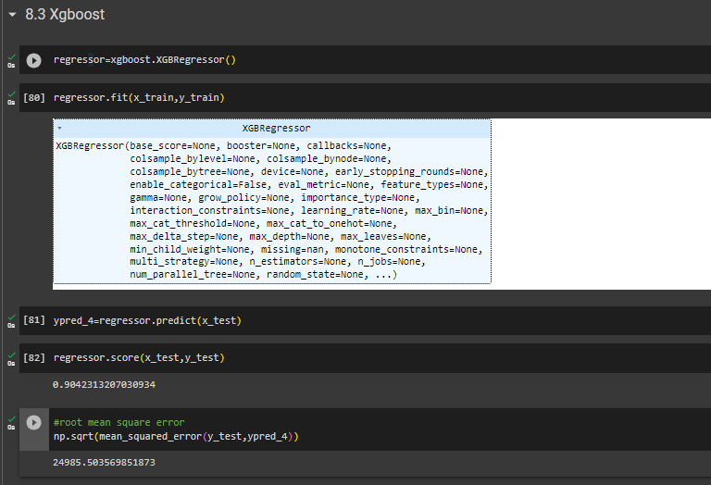

Slide 29
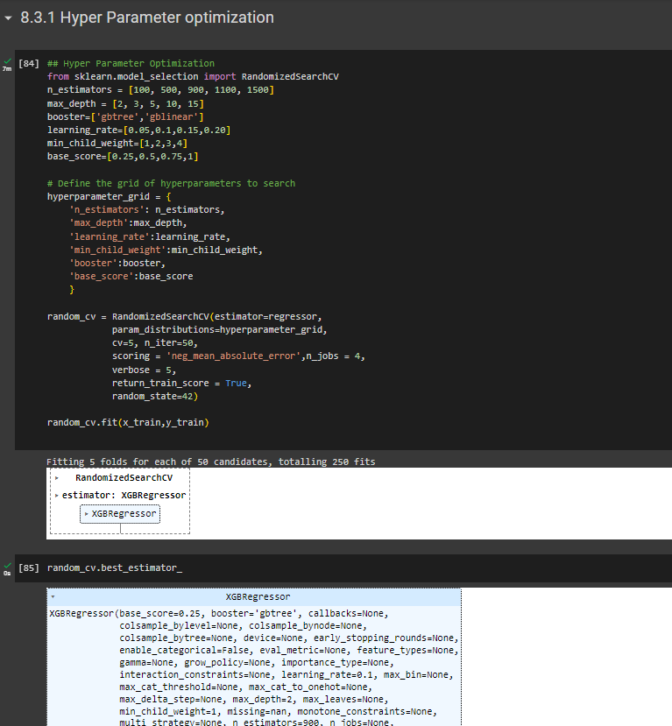

Slide 30
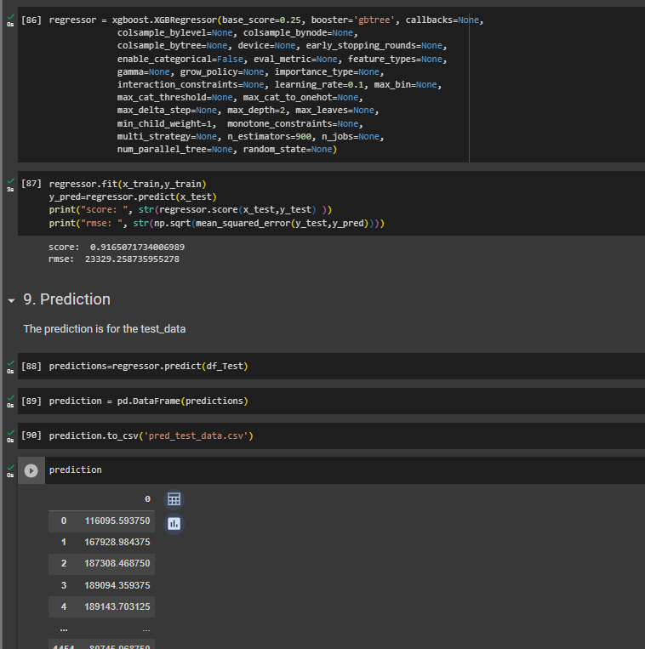

Slide 31
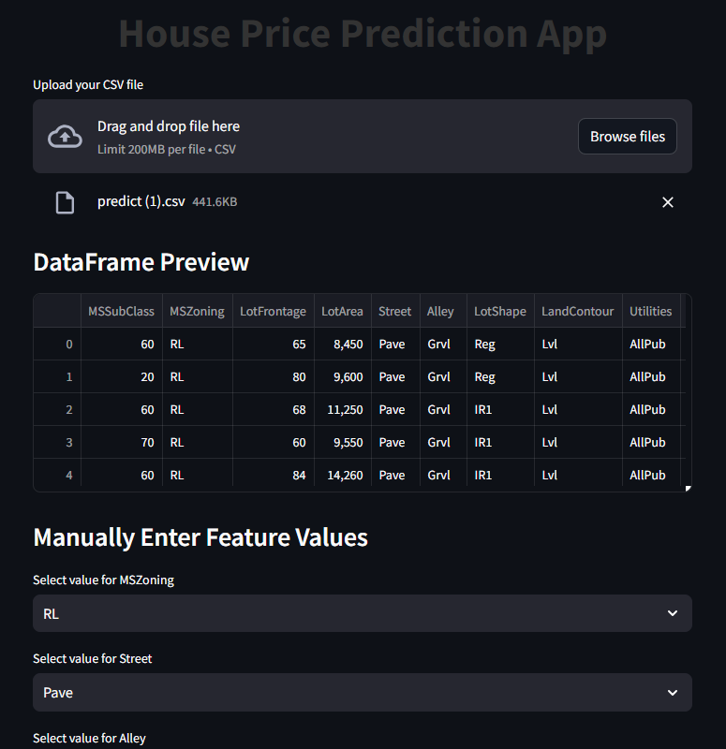
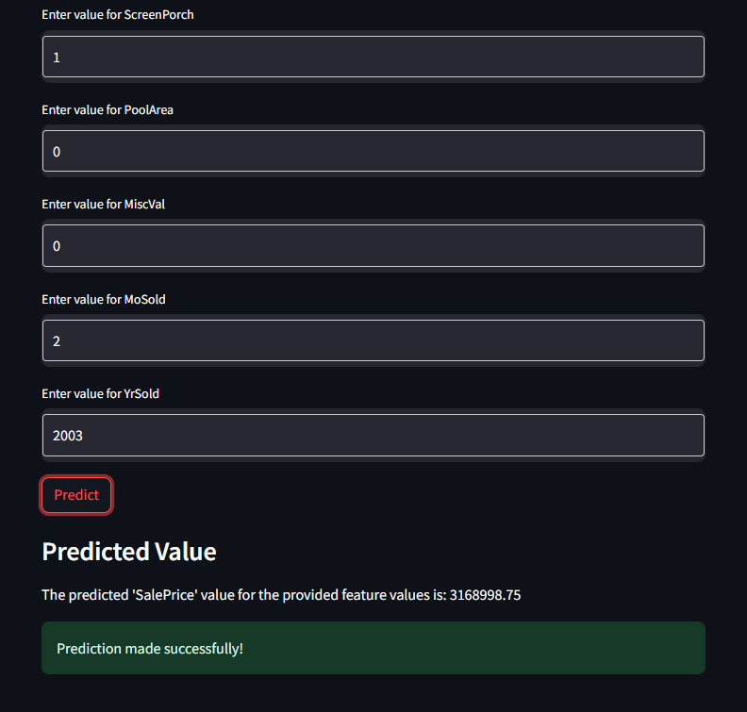
Prediction
We have created a webpage to predict the saleprice of the house.

Slide 32
Thank you

